Slide 1
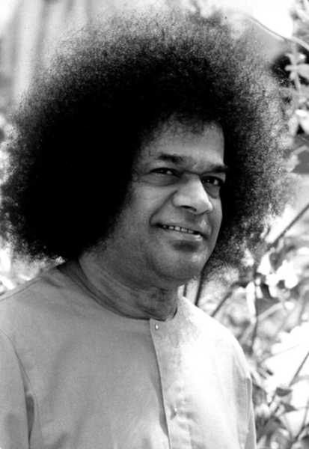
Cattle verification with YOLO and cross-attention encoder-based pairwise triplet loss
Presented by:
Sai Narendra
Supervised By:
Prof. SVSN Sarma, Asst. Professor, Mathematics & Computer Science, SSSIHL
Dr. Darshan Gera, Associate. Professor, Mathematics & Computer Science, SSSIHL

Slide 2
PROBLEM STATEMENT:
Traditional cattle identification methods like ear tags or branding are invasive, unreliable, and prone to fraud.
Existing deep learning models using only face or muzzle images struggle with lighting, pose, and occlusion variations, limiting verification accuracy.
There is a need for a robust, non-invasive, and efficient verification system that performs reliably in real-world conditions.
This study proposes a Cross-Attention Encoder with Pairwise Triplet Loss that fuses face and muzzle features to enhance accuracy, feature alignment, and scalability in cattle verification.
Referenced Paper:
Shojaeipour, A., Falzon, G., Kwan, P., Hadavi, N., Cowley, F. C., & Paul, D. (2021). Automated muzzle detection and biometric identification via few-shot deep transfer learning of mixed breed cattle. Agronomy, 11(11), 2365. https://doi.org/10.3390/agronomy11112365

Slide 3
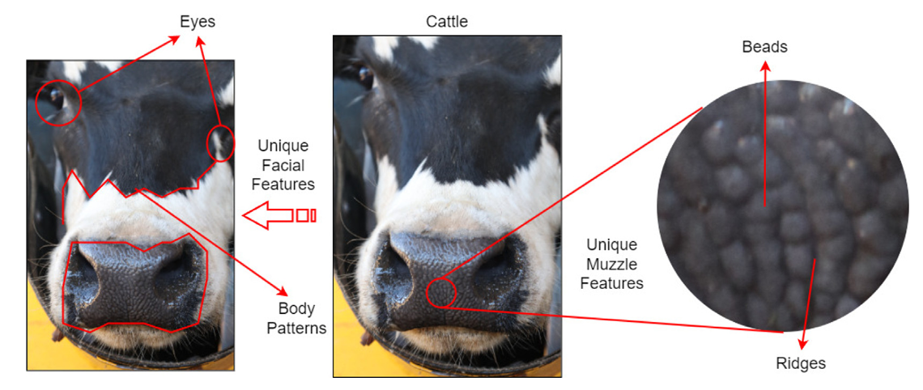
Fig1: Illustration of distinctive facial and muzzle features in cattle used for individual recognition. The left section highlights key facial features, including the eyes, body patterns, and overall unique facial contours, and on the right, a magnified view of the muzzle reveals specific beads and ridges, i.e., microscopic details unique to each cattle’s muzzle pattern.

Slide 4
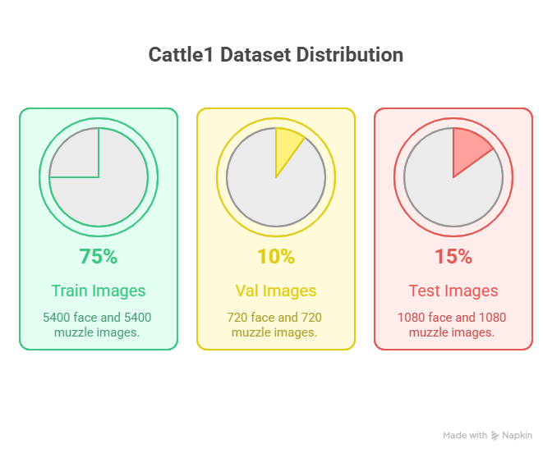
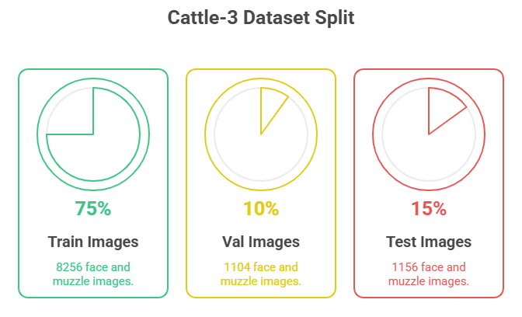
DATASETS USED:
Cattle-1-dataset
Cattle-3-dataset
Shojaeipour, A., Falzon, G., Kwan, P., Hadavi, N., Cowley, F. C., & Paul, D. (2021). Automated muzzle detection and biometric identification via few-shot deep transfer learning of mixed breed cattle. Agronomy, 11(11), 2365.

Slide 5
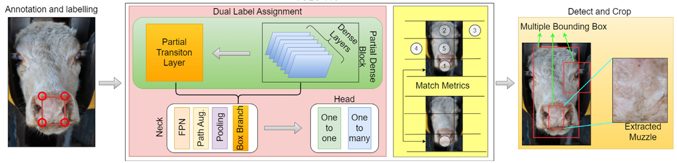
YOLO TRAINING PROCESS:
Manually annotated muzzle regions using the Roboflow application.
Downloaded the annotated images and performed dataset splitting.
Trained a YOLOv11 model specifically for muzzle region detection.
Utilized the trained YOLOv11 model to extract muzzle regions from the images.
YOLO v11 muzzle detection and cropping from cattle face images. The central section including the Backbone and layers, which are responsible for feature extraction and detection refinement. The match metrics at the bottom ensure accurate localization.

Slide 6
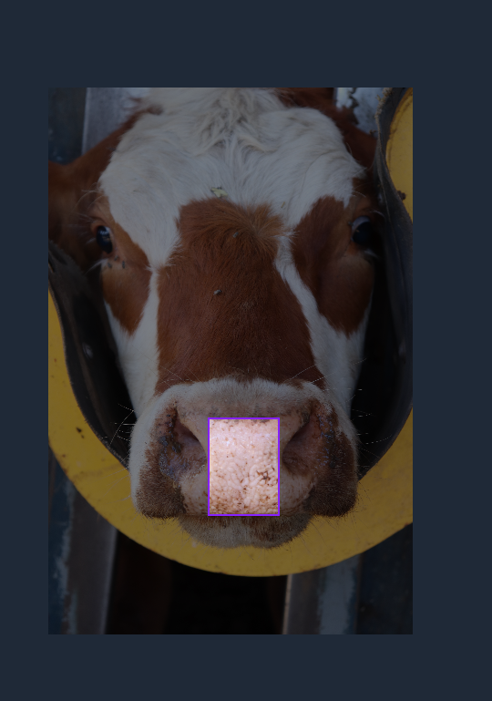
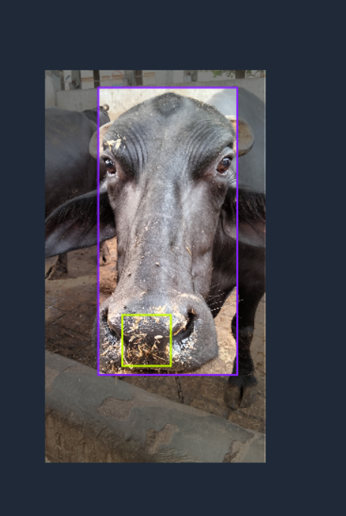
YOLO TRAINING PROCESS:
Manually annotated muzzle regions using the Roboflow application.
Downloaded the annotated images and performed dataset splitting.
Trained a YOLOv11 model specifically for muzzle region detection.
Utilized the trained YOLOv11 model to extract muzzle regions from the images.

Slide 7
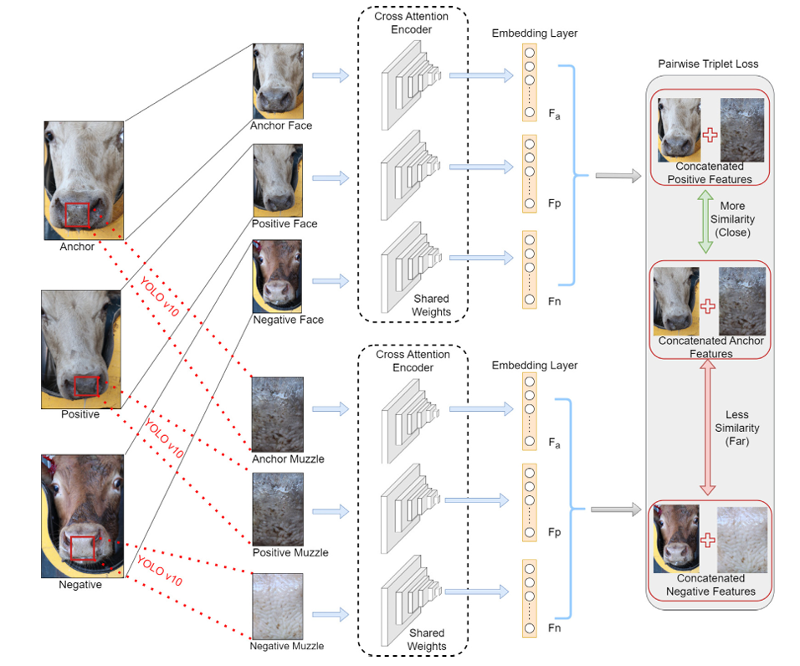
METHODOLOGY:

Slide 8
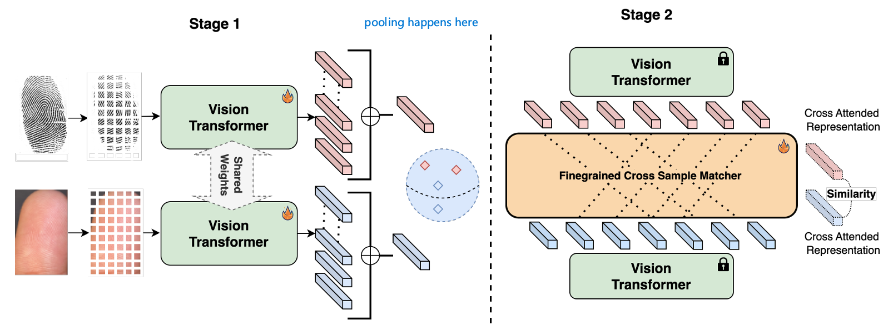
OTHER PIPELINE I FOLLOWED:
Pandey, S., Jawade, B., & Setlur, S. (2025). Ridgeformer: Multi-stage contrastive training for fine-grained cross-domain fingerprint recognition. In 2025 IEEE International Conference on Image Processing (ICIP). IEEE. (Original work published as arXiv preprint arXiv:2506.01806). https://arxiv.org/abs/2506.01806

Slide 9
LITERATURE VIEW:
RIDGEFORMER:MUTLI-STAGECONTRASTIVETRAININGFORFINE-GRAINED CROSS-DOMAINFINGERPRINTRECOGNITION
Cattle verification with YOLO and cross-attention encoder-based pairwise triplet loss
MHAFF: Multi-Head Attention Feature Fusion of CNN and Transformer for Cattle Identification
Automated Muzzle Detection and Biometric Identification via Few-Shot Deep Transfer Learning of Mixed Breed Cattle
Shojaeipour, A., Falzon, G., Kwan, P., Hadavi, N., Cowley, F. C., & Paul, D. (2021). Automated muzzle detection and biometric identification via few-shot deep transfer learning of mixed breed cattle. Agronomy, 11(11), 2365. https://doi.org/10.3390/agronomy11112365
Kumar, N., Sharma, A., Kumar, A., Singh, R., & Singh, S. K. (2025). Cattle verification with YOLO and cross-attention encoder-based pairwise triplet loss. Computers and Electronics in Agriculture, 234, 110223. https://doi.org/10.1016/j.compag.2025.110223
Pandey, S., Jawade, B., & Setlur, S. (2025). Ridgeformer: Multi-stage contrastive training for fine-grained cross-domain fingerprint recognition. In 2025 IEEE International Conference on Image Processing (ICIP). IEEE. (Original work published as arXiv preprint arXiv:2506.01806). https://arxiv.org/abs/2506.01806
Dulal, R., Zheng, L., & Kabir, M. A. (2025). MHAFF: Multihead attention feature fusion of CNN and transformer for cattle identification. IEEE Transactions on AgriFood Electronics. Advance online publication. https://doi.org/10.1109/TAFE.2025.3574708

Slide 10
RESULTS:
 | CATTLE-1-DATASET |  | CATTLE-3-DATASET
 | Author | Mine | Mine
Accuracy | 93.67 | 96.67 | 97
Precision | 92.34 | 93.1 | 97
Recall | 92.89 | 90 | 97
F1-Score | 92.61 | 91.5 | 97
AUC | 93.6 | 97.1 | 97
FAR | 0.1114 | 0.06 | 0.029
FRR | 0.1761 | 0.1 | 0.029
Threshold | 6 | 6 | 6

Slide 11
FUTURE WORK:
Design a Novel Pipeline for cattle verification
Experimenting with other datasets
Experimenting with other models
Experimenting with different losses

Slide 12
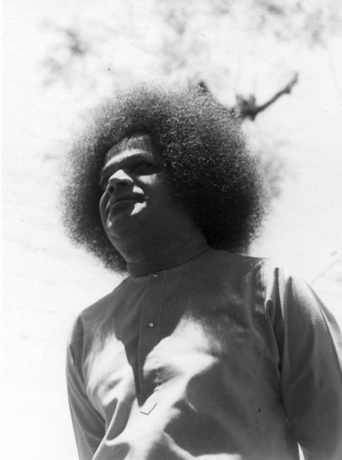
THANK YOU!

